Slide 1
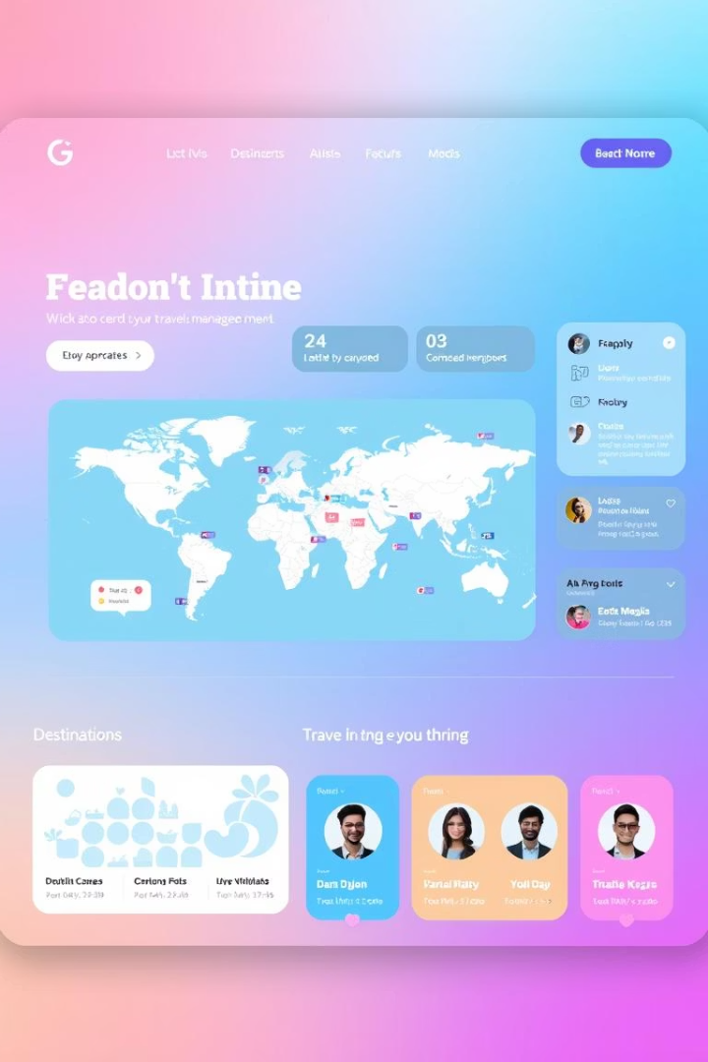
Travel Management System: Project Summary
This client-side web application offers a seamless experience for browsing, booking, and managing travel packages. It is built using standard web technologies: HTML, CSS, and JavaScript.
MD Tabish Zubair 22SCSE1011255

Slide 2
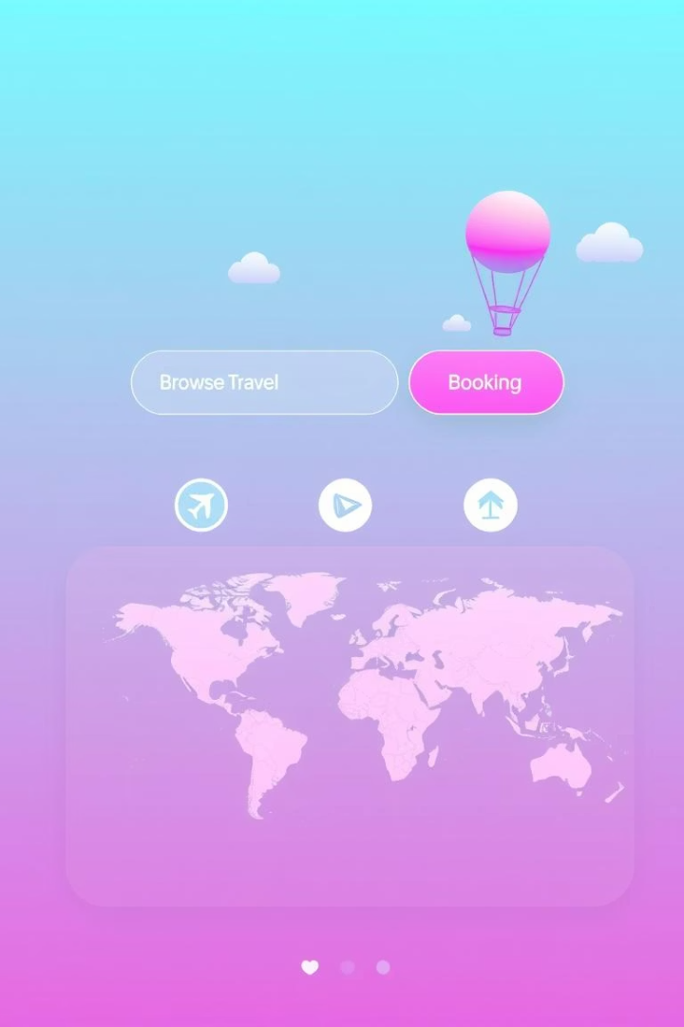
Project Overview
Browse Packages
View Details
Explore a wide selection of travel packages.
Access comprehensive package information with images.
Book & Manage
Securely book and manage your travel itineraries.
The system allows users to browse available travel packages. It displays detailed package information with image galleries and enables users to book packages. All user bookings are managed through local storage.

Slide 3



Key Features: Travel Packages
Users can easily browse a variety of exciting travel packages. Each package offers detailed descriptions and captivating image galleries for an immersive experience.

Slide 4
Key Features: Booking & Management
Seamless Booking
Local Storage
Book travel packages effortlessly and securely.
Manage and view all your bookings conveniently.
The system facilitates easy and secure booking of travel packages. All booking information is stored locally for convenient management and retrieval by the user.

Slide 5
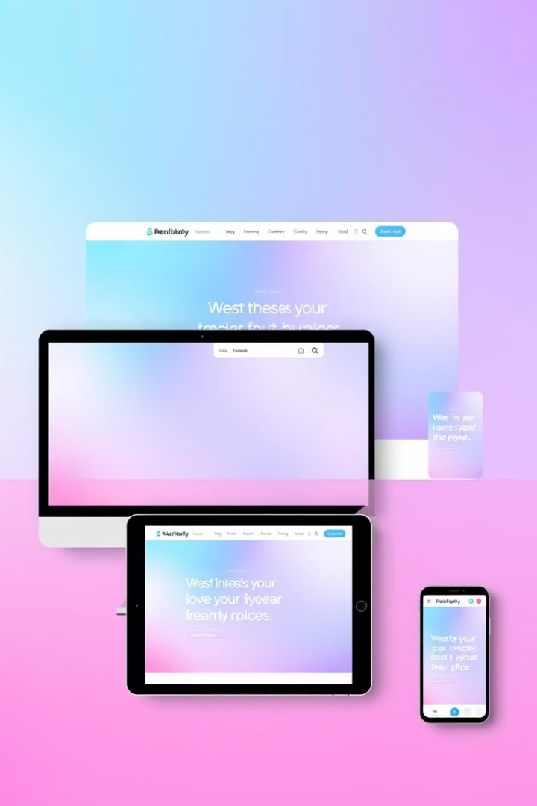


Interactive UI
Responsive Design
User-Friendly
Adapts seamlessly to various screen sizes.
Intuitive navigation and interface for all users.
The user interface is designed to be highly interactive and intuitive. Its responsive design ensures a consistent experience across all devices, from desktops to smartphones.

Slide 6
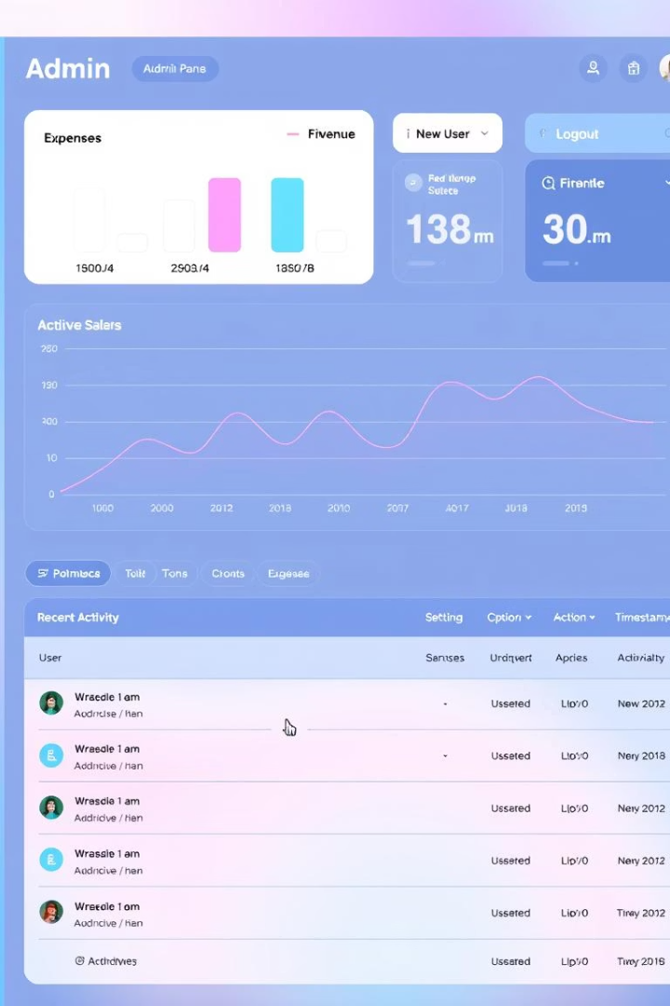
Admin Login
Access Control
Access the administrative panel with dedicated credentials.
Credentials
Username: admin
Password: admin123
The system includes an administrative login for internal management. Access to the admin panel is secured using hardcoded credentials for quick setup and demonstration purposes.

Slide 7



Tech Stack
JavaScript
1
For interactivity and dynamic functionality.
CSS
2
For styling and visual presentation.
HTML
3
For structuring web content.
The application is built upon a robust tech stack. HTML provides the structural foundation, CSS handles the styling, and JavaScript delivers dynamic interactivity. LocalStorage is used for client-side data persistence.

Slide 8





Future Enhancements
Database Integration
Implement a real database for persistent data storage.
Backend Development
Develop a robust backend with secure user authentication.
Payment Gateway
Integrate a secure payment system for transactions.
Reviews & Ratings
Add a user review and rating system.
Future plans include migrating to a real database like MongoDB or PostgreSQL. Developing a robust backend with user authentication and integrating a payment gateway will enhance functionality. A user review and rating system will also be added.

Slide 9

THANK YOU!

